Slide 1
Chemicals and the Environment
Section 1.1 and 1.3

Slide 2
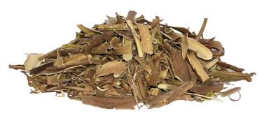
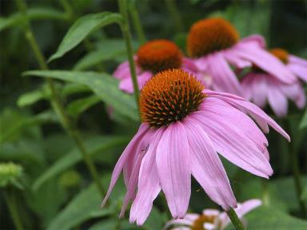
What do these have in Common??
Willow Bark
Purple Cone Flower

Slide 3
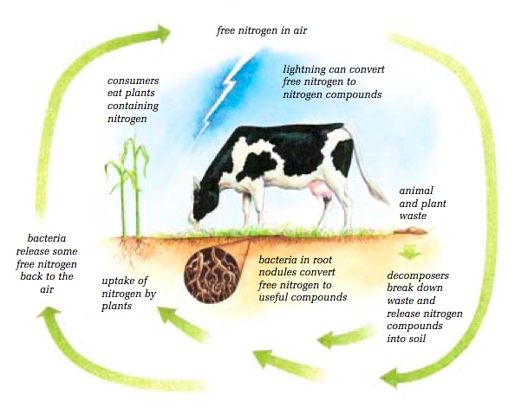
Nitrogen Cycle

Slide 4
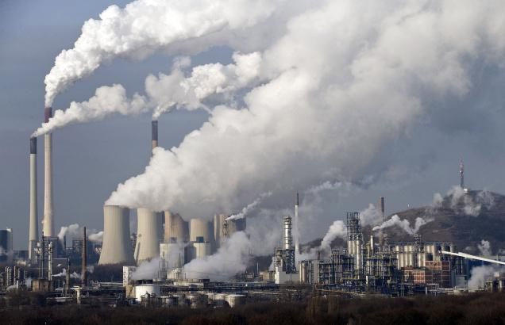
Pollution

Slide 5
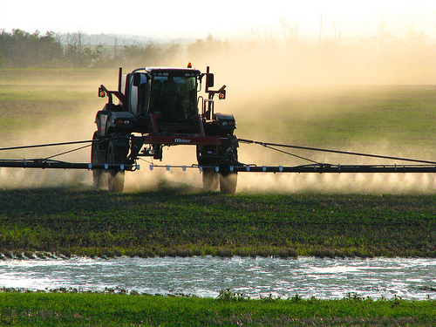
Fertilizers/Pesticides

Slide 6
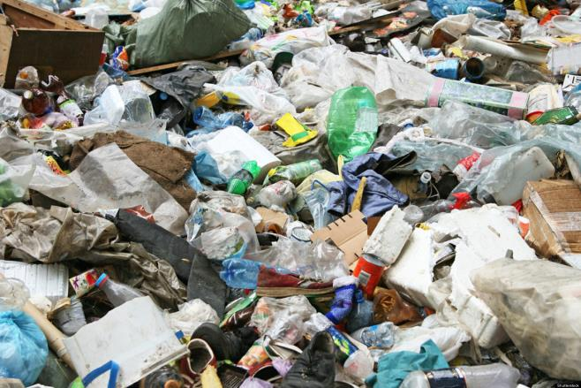
Solid Wastes

Slide 7
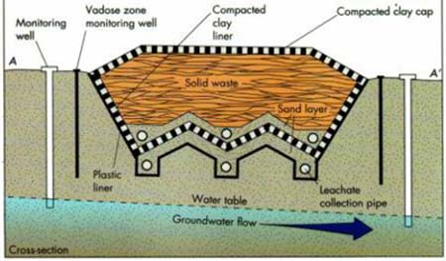

Slide 8
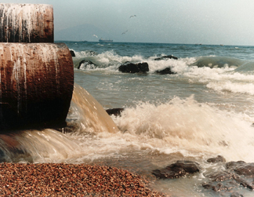
Wastewater

Slide 9
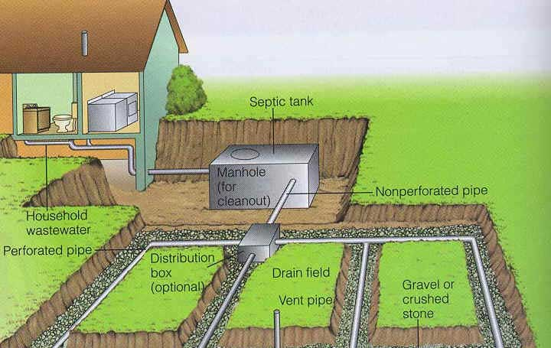
Septic Tanks

Slide 10
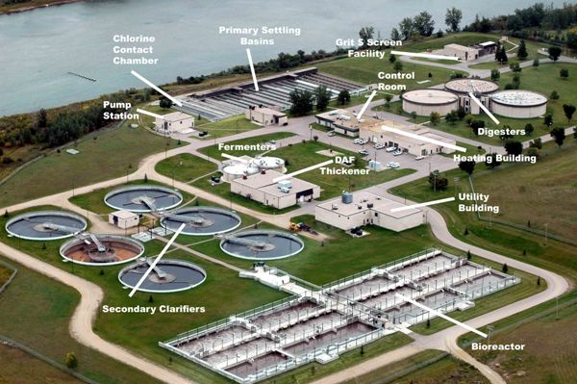
Sewage Treatment Plant

Slide 11
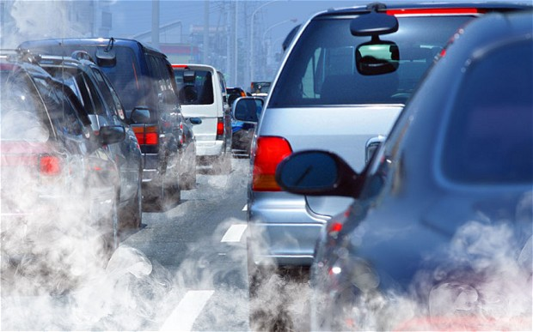
Combustion

Slide 12
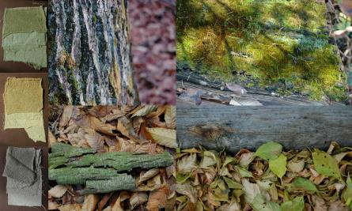
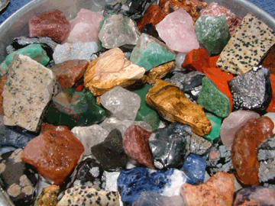
Common Substances for Living
Inorganic
Organic

Slide 13
Organic or Inorganic?
Substance | Organic? | Inorganic?
Oxygen
Distilled Water
Sugar
Motor Oil
Hydrochloric Acid
Rust
Vitamin C
Glass
Fat
Rubber

Slide 14
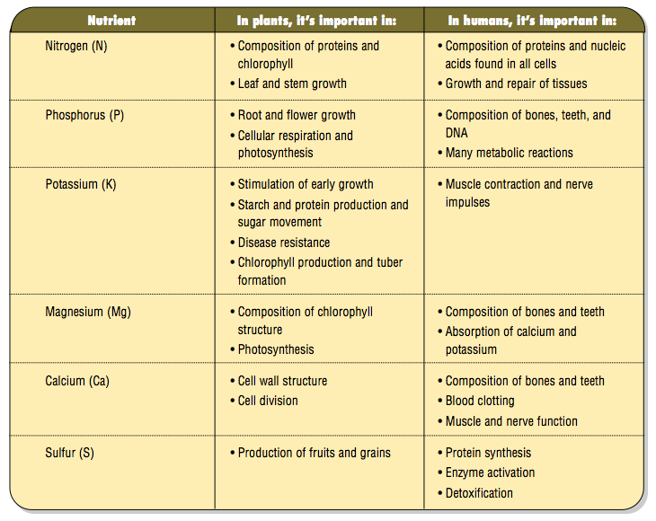
Marco Nutrients

Slide 15
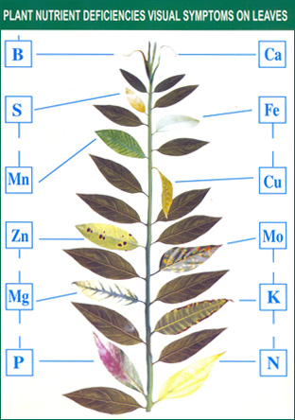
Examples

Slide 16
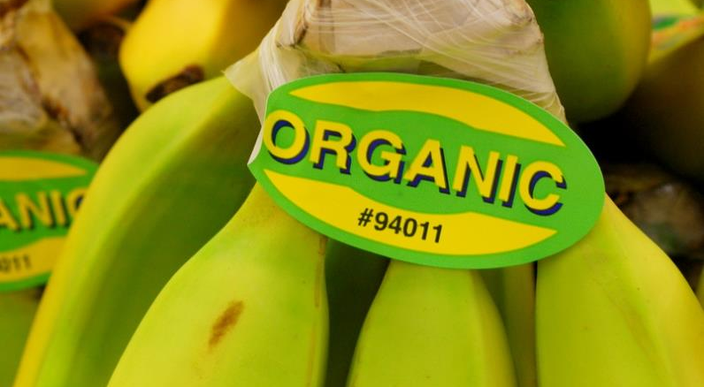
Organic Compounds

Slide 17
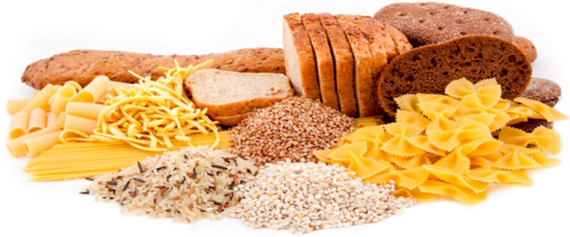
Carbohydrates

Slide 18

Lipids

Slide 19
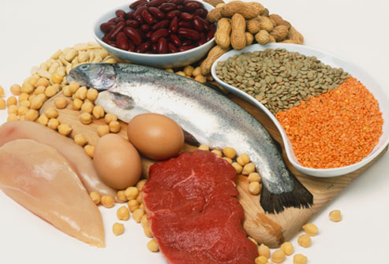
Proteins and Amino Acids

Slide 20
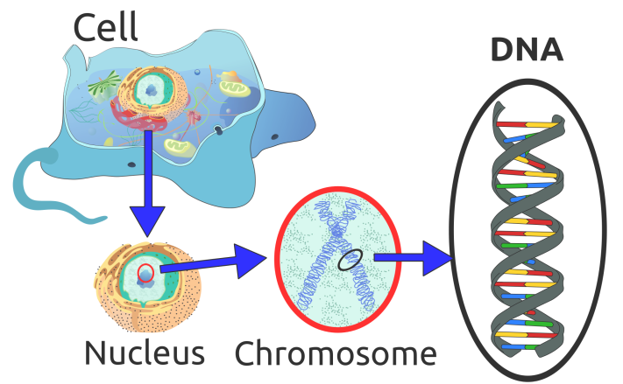
Nucleic Acids

