Slide 1
Monitoring Air Quality
Section 2.2 – 2.3

Slide 2
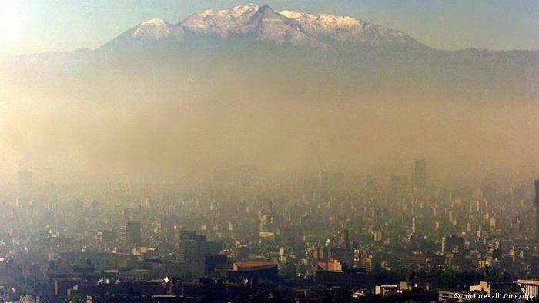
Pollution?

Slide 3
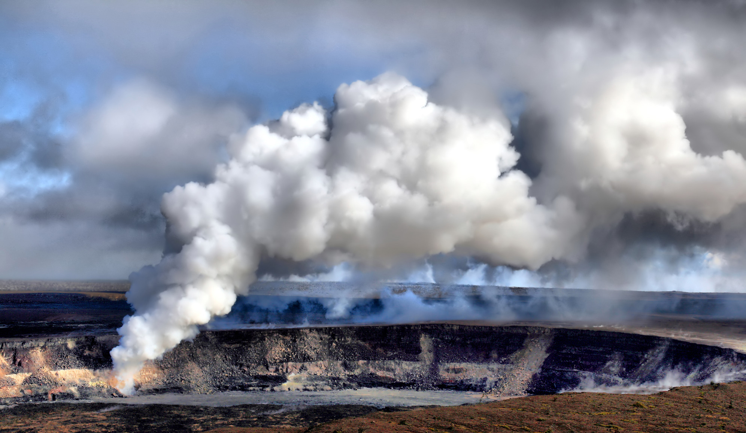
Sulfur Dioxide

Slide 4
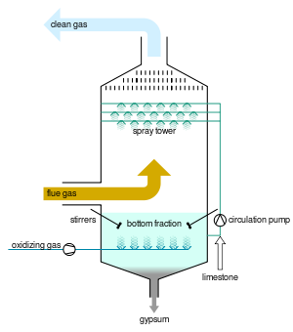
Scrubbing

Slide 5
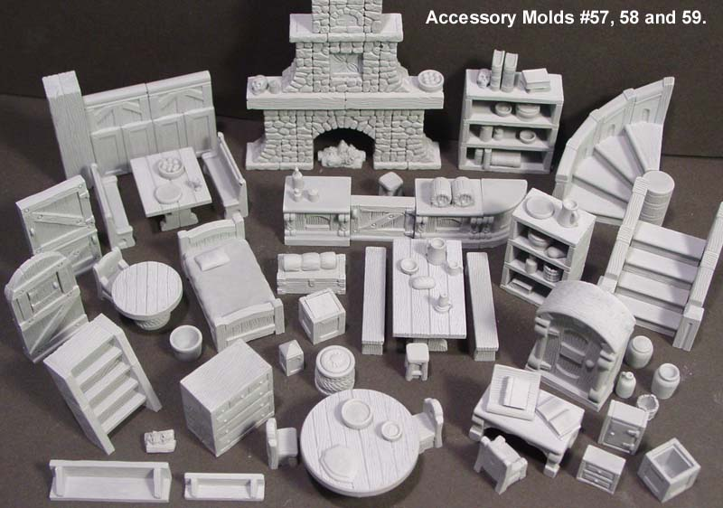
GYPSUM!

Slide 6
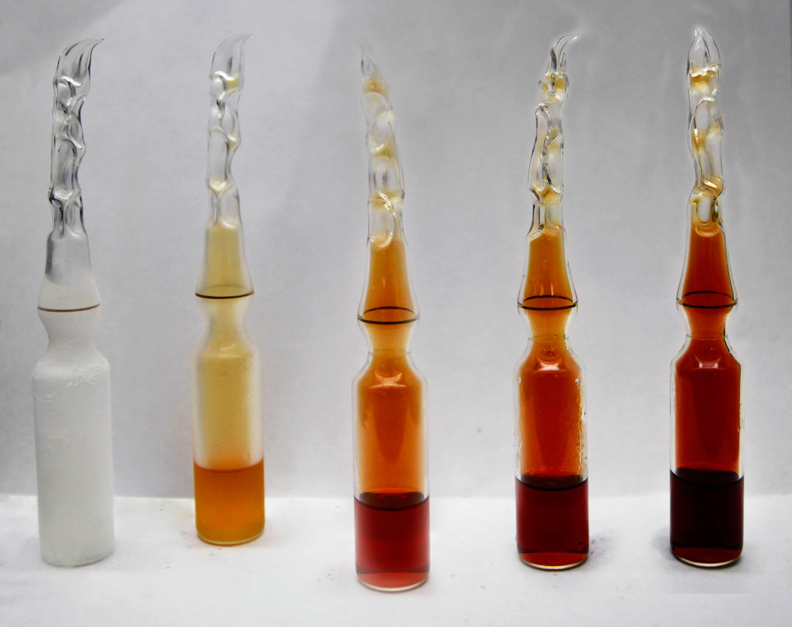
Nitrogen Oxides

Slide 7
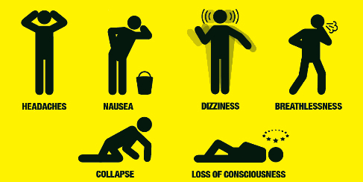
Carbon Monoxide

Slide 8
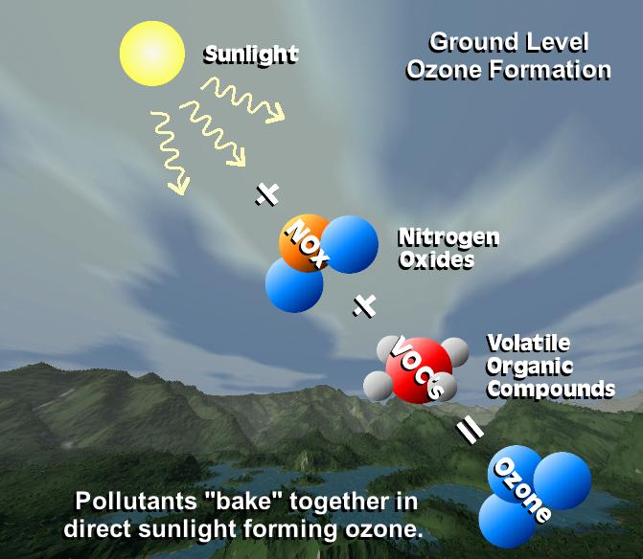
Ozone

Slide 9
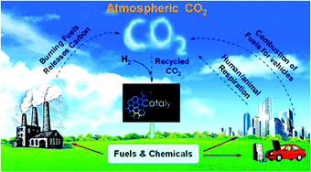
Carbon Dioxide

Slide 10
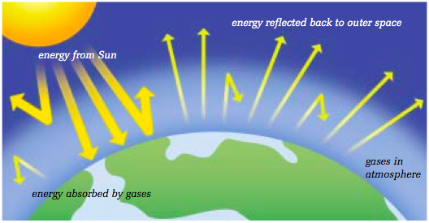
Greenhouse Effect

Slide 11
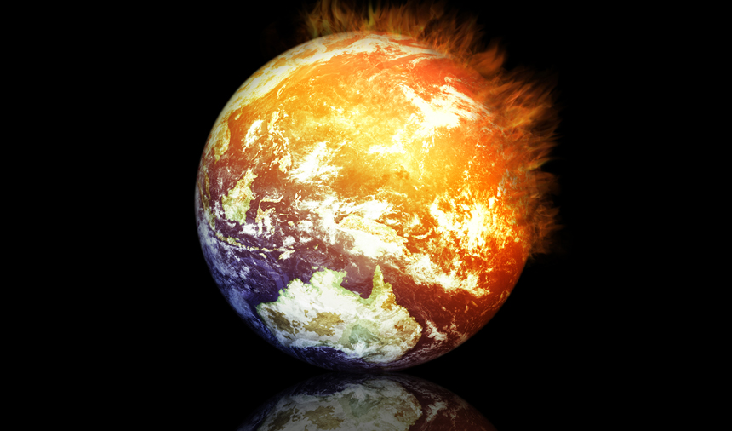
Global Warming

Slide 12

Global Warming
https://www.youtube.com/watch?v=ffjIyms1BX4&feature=youtu.be

Slide 13
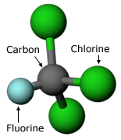
CFCs

