Slide 1
Monitoring Water Quality
Section 2.0

Slide 2
Celery Lab
What happened to the celery?
What kind of transport was used?

Slide 3
Review
Pg. 211
Questions 1-3, 5-11
QUIZ TOMORROW!

Slide 5
Monitoring Water Quality
Safe to Drink?

Slide 6
Five Categories of Water Use

Slide 7
Human Drinking Water (Potable)

Slide 8
Recreation, such as Swimming

Slide 9
Livestock Drinking Water

Slide 10
Irrigation (Watering)

Slide 11
Protection of Aquatic Life

Slide 12
What do we look for?

Slide 13
Biological Indicators

Slide 14
Microbiological Indicators

Slide 15
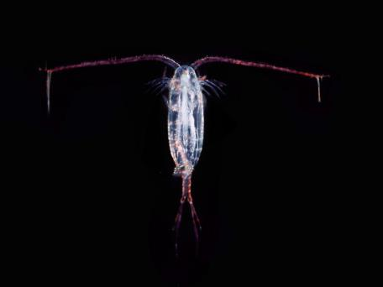
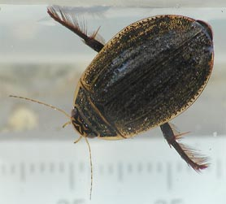
Aquatic Invertebrates

Slide 16
BUGS!!!

Slide 17
Chemical Factors that Affect Organisms

Slide 18
Measuring Chemicals in the Environment

Slide 19
Dissolved Oxygen

Slide 20
P and N Content

Slide 21
Acidity

Slide 22
Pesticides

Slide 23
Heavy Metals

Slide 24
Measuring Toxicity

Slide 25
LD50

Slide 26
Other LDs

Slide 27
Suspended Solids
Secchi Disk

Slide 28
Practice
Pg. 224
Questions 1-10
Quiz on Section 1

