Slide 1
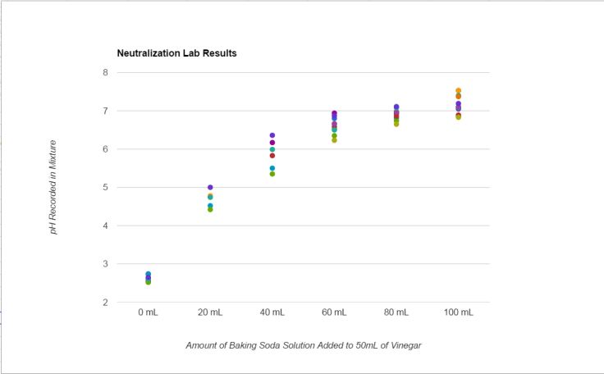
Acid and Base Review

Slide 2
How Organisms Take in Food
Section 1.4

Slide 3
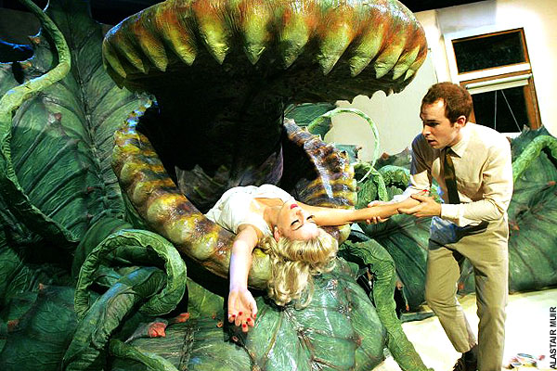
Plants

Slide 4
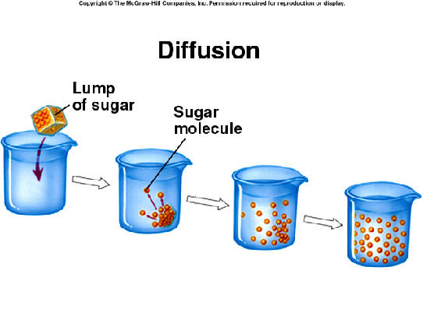
Diffusion

Slide 5
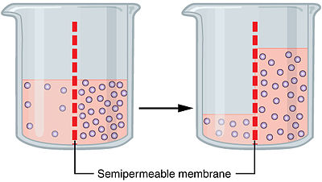
Osmosis

Slide 6
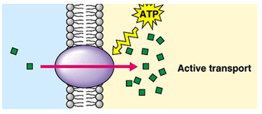
Active Transport

Slide 7
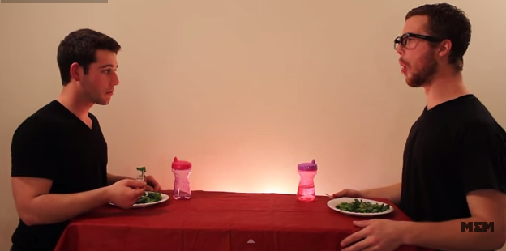
Animals
https://www.youtube.com/watch?v=qnydFmqHuVo

Slide 8
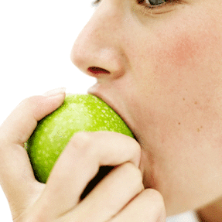
Mechanical

Slide 9
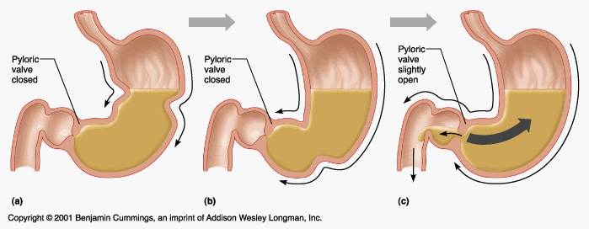
Chemical

Slide 10
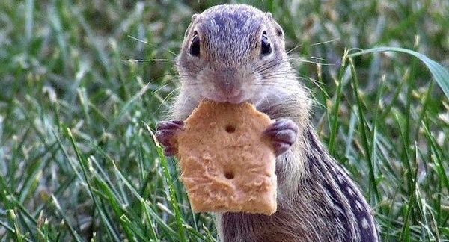
Hydrolysis

Slide 11
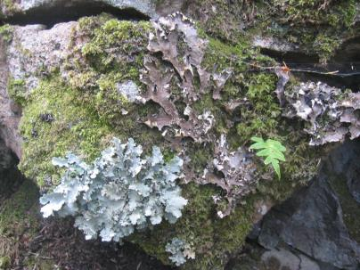
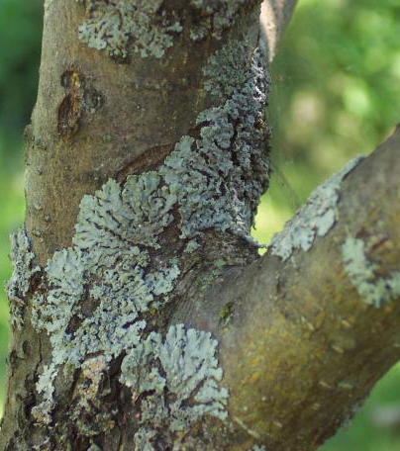
Substrates

