Slide 1
Atomic Theory
Lesson 3

Slide 2

Billiard Ball Model

Slide 3
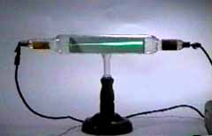
Cathode Rays

Slide 4
Video
https://www.youtube.com/watch?v=O9Goyscbazk

Slide 5
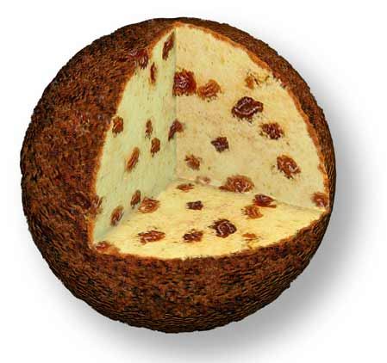
Raisin Bun Model

Slide 6
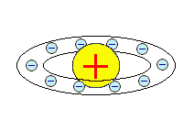
Solar Model

Slide 7
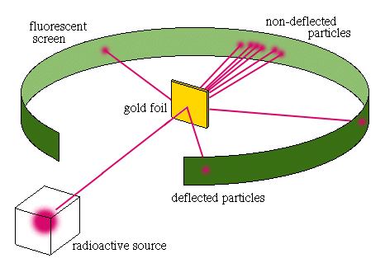
Rutherford Experiment

Slide 8
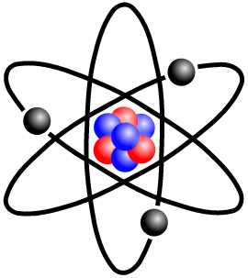
Bohr’s Model

Slide 9
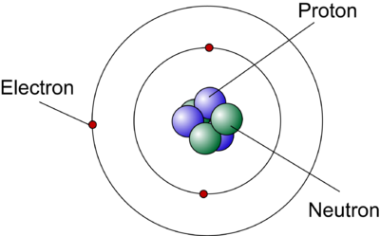
The Neutron

