Slide 1
The More you Know!
A review of concepts up to NOW

Slide 2
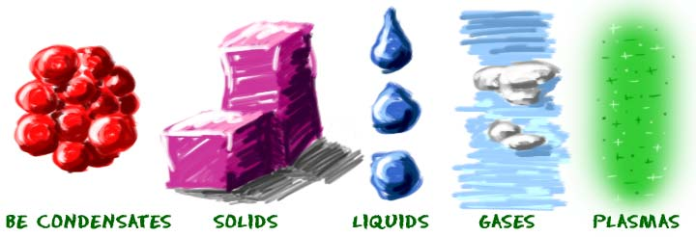
Matter

Slide 3
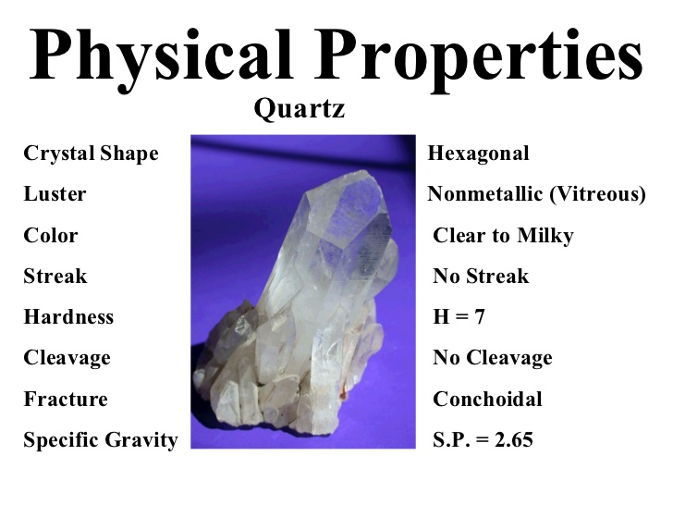
Physical properties

Slide 4
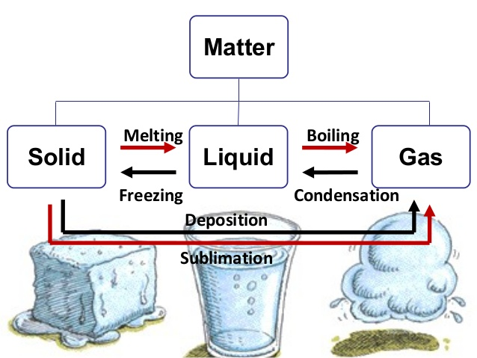
Physical Change

Slide 5
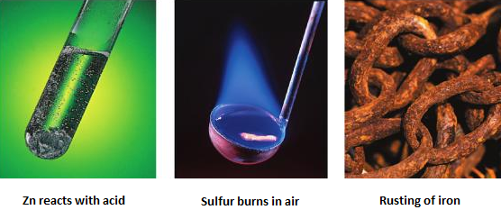
Chemical properties

Slide 6
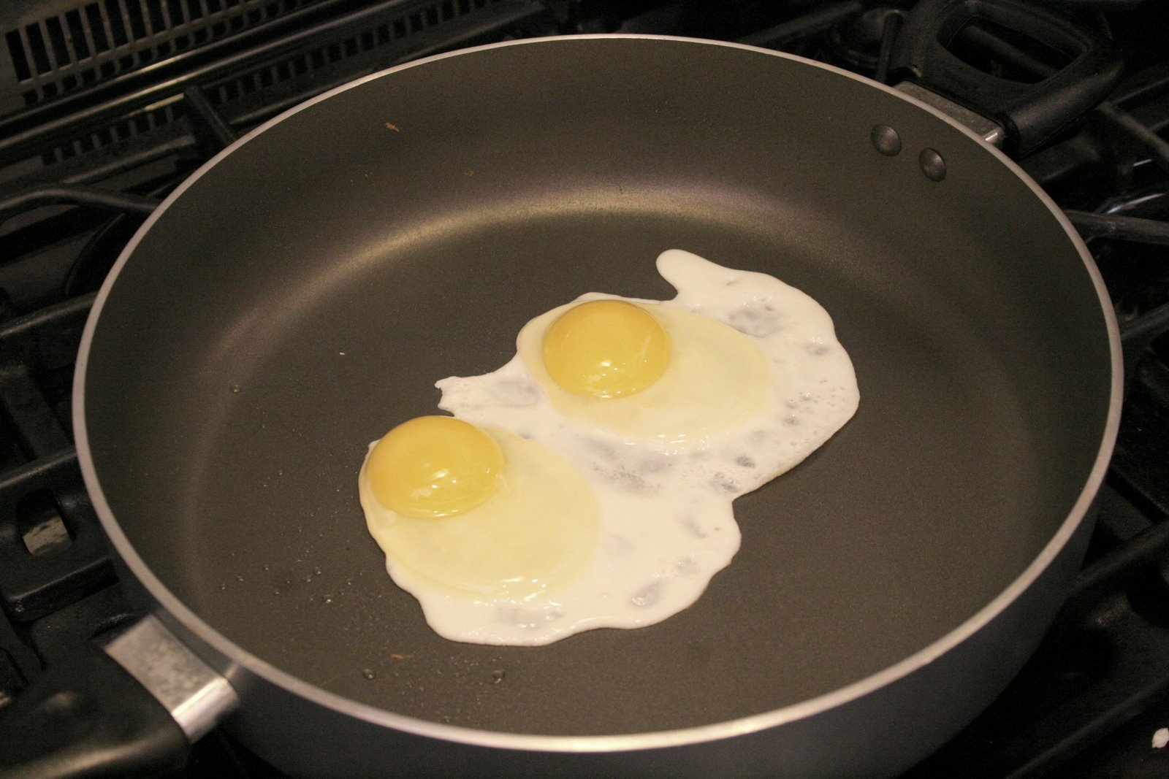
Chemical Change

Slide 7
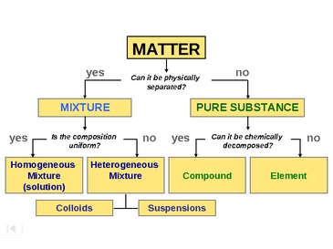
Classifying Matter

Slide 8

WHMIS/GHS

Slide 9
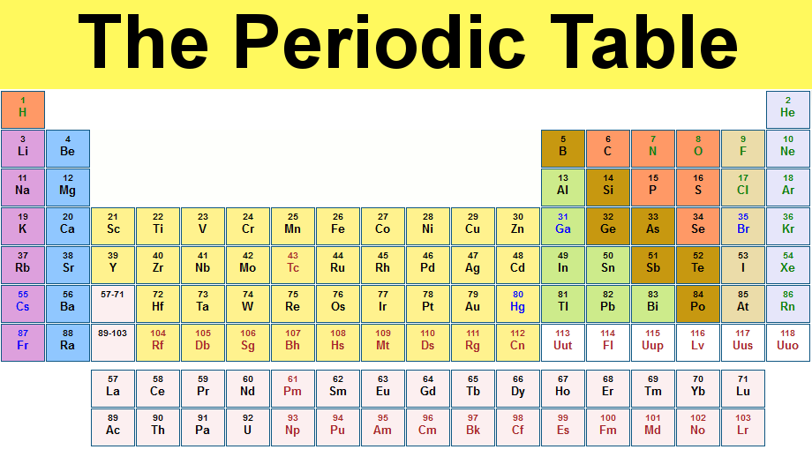
Periodic Table

Slide 10
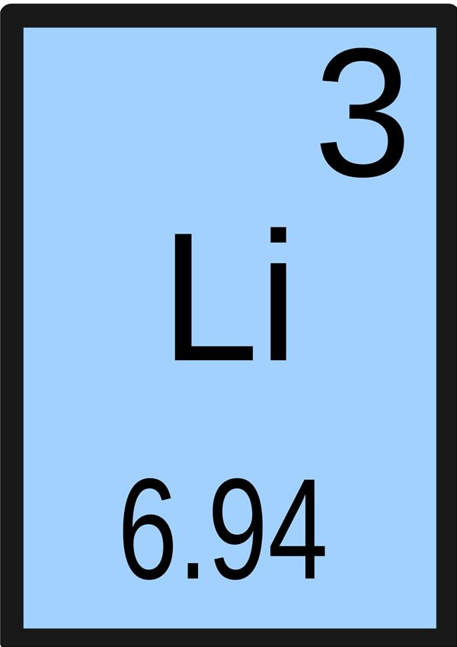
Element Symbols

Slide 11
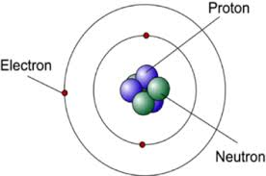
Number of Subatomic Particles

Slide 12
Compounds
Ionic
Molecular (Covalent)
High Boiling Point
Metals and Non-metals
Conducts Electricity
Give or Take Electrons
Low Boiling Point
Only Non-Metals
Insulators
Share Electrons

Slide 13
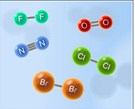
Diatomic Elements

Slide 14

IUPAC

Slide 15
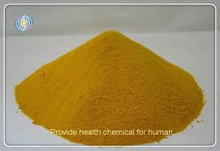
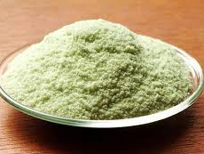
Transition Metals
FeCl₃
FeCl₂

