Slide 1
Organizing the Elements
Lesson 4

Slide 2

Organizing the Elements

Slide 3
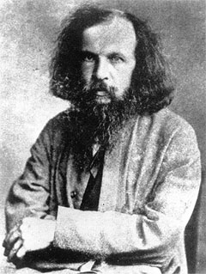
Finding a Pattern

Slide 4
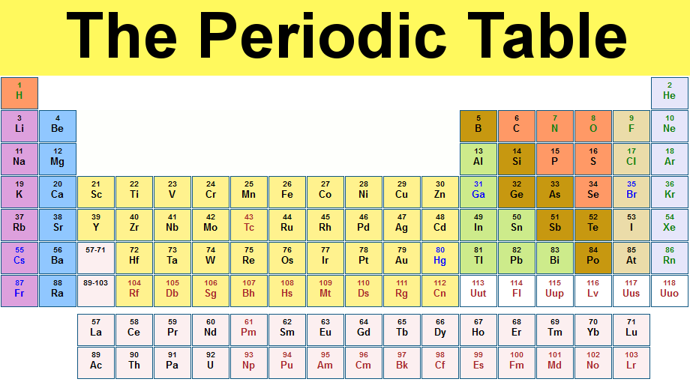
Periodic Table

Slide 5
Periodic Table Information
17
Cl
Chlorine
35.5

