Slide 1
Evolving Theories of Matter
Lesson 2

Slide 2
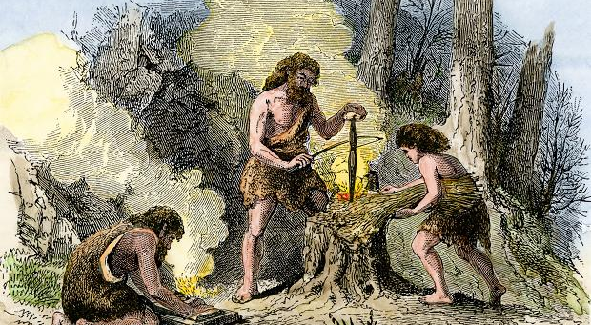
Stone Age Chemists

Slide 3
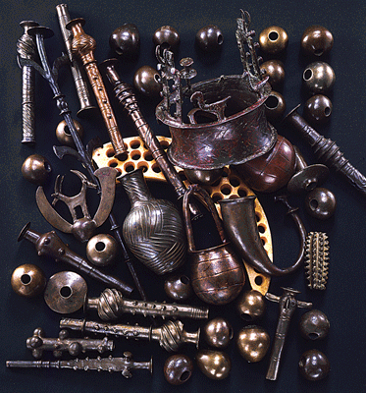
Metal Age Chemists (Metallurgy)

Slide 4
Video
https://www.youtube.com/watch?v=8uHc4Hirexc

Slide 5
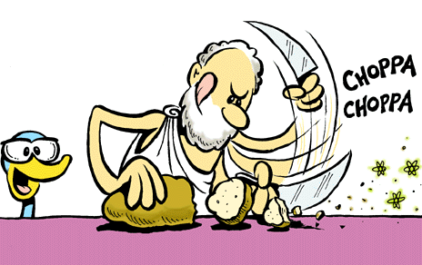
Beginnings of Matter

Slide 6
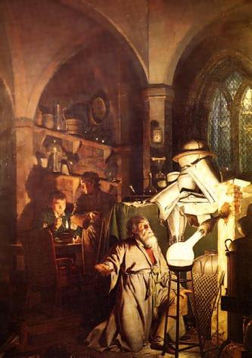
Alchemy

Slide 7

Modern Chemistry

