Slide 1
Genetics
Lesson 8

Slide 2
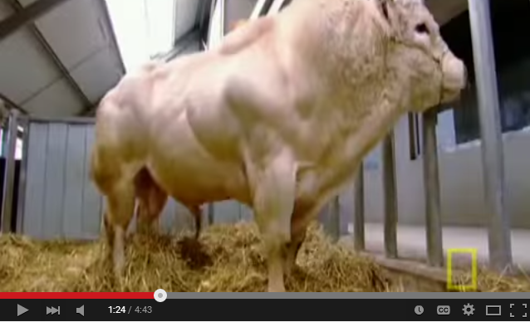
Meet the Super Cow https://www.youtube.com/watch?v=Nmkj5gq1cQU

Slide 3
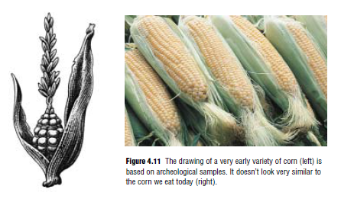
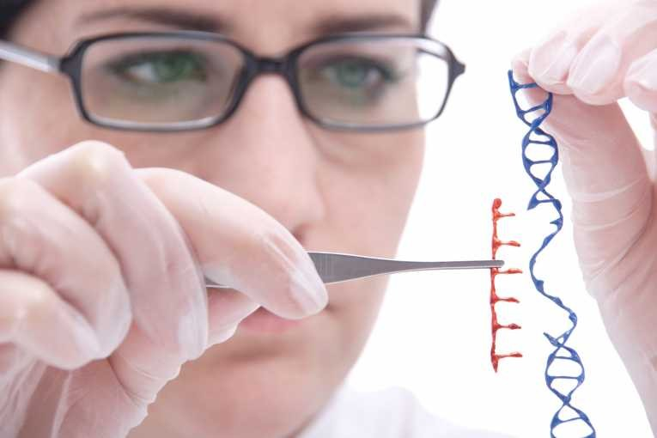
Reproductive Technologies
Selective Breeding
Genetic Engineering

Slide 4
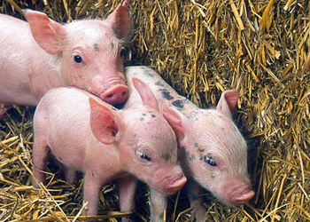
EnviroPig https://www.youtube.com/watch?v=mAfCauLF-14

Slide 5
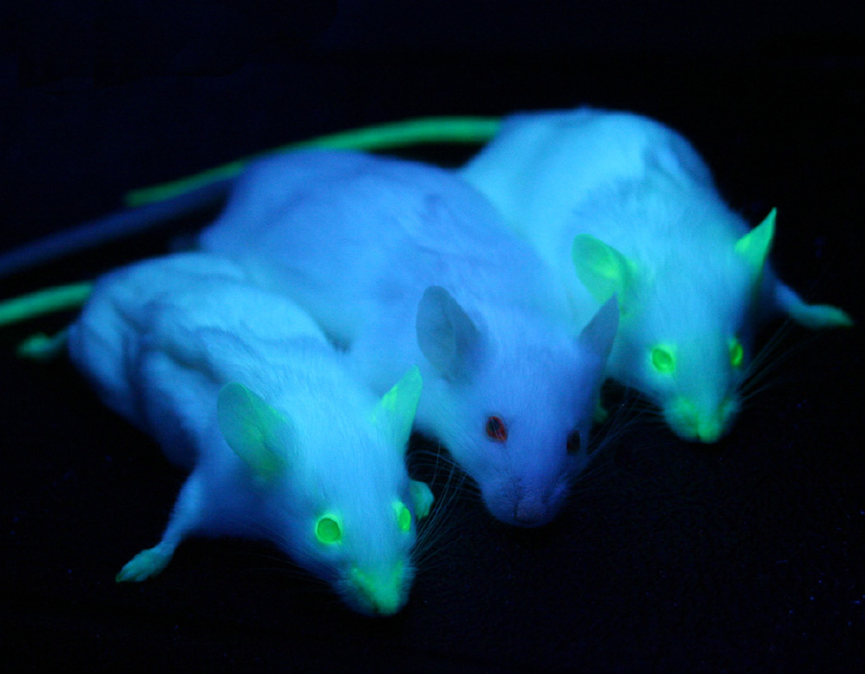
Transgenic Animals http://channel.nationalgeographic.com/videos/transgenic-animal-creations/

Slide 6
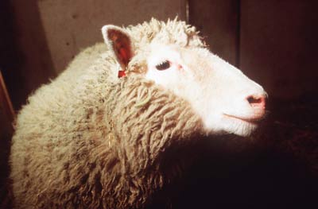
Cloning

Slide 7
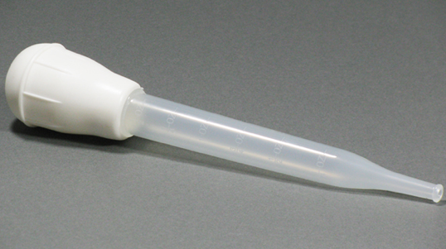
Artificial Insemination

Slide 8
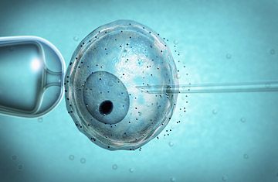
In Vitro Fertilization

Slide 9
Practice
Pg. 71 #1,2,3,5
How does artificial selection differ from what you learned earlier in this unit about natural selection? Use examples in your explanation.
Describe two examples of technologies that humans use to select the traits of organisms.
Who were the earliest “plant technologists” in North America? What crop did they develop and how?
Simplify an explanation of artificial selection in a way that a student in grade 4 could easily understand it.

Slide 10
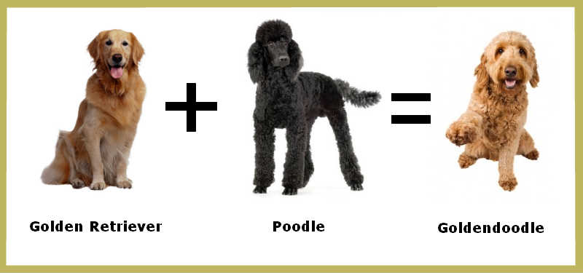
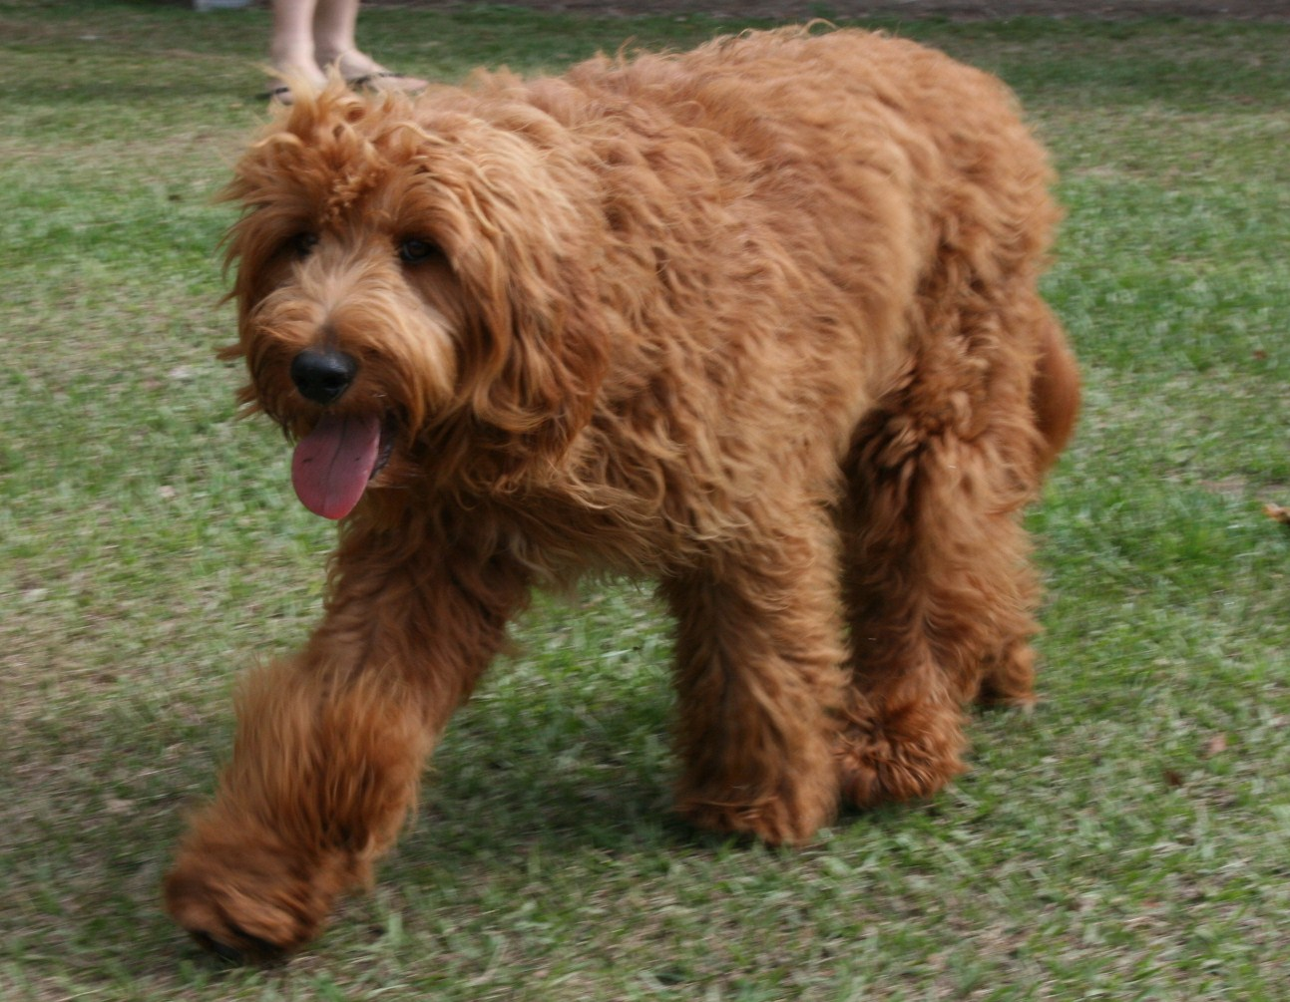
Patterns of Inheritance
Purebred
Hybrid

Slide 11
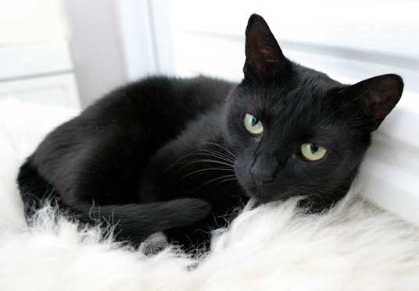
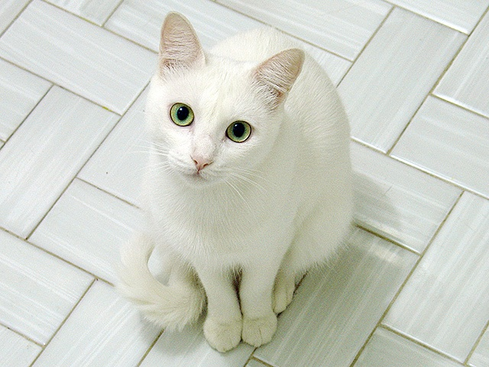
Traits
Dominate
Recessive

Slide 12
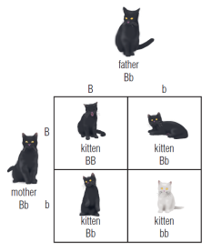
Punnett Squares

Slide 13
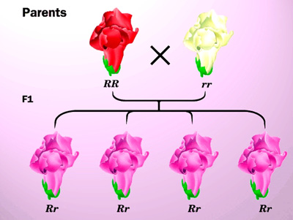
Incomplete Dominance

Slide 14

Offspring Unlike Either Parents

Slide 15
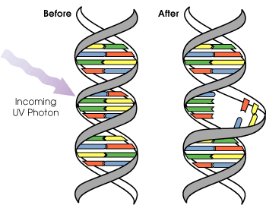
Environmental Factors

Slide 16
Practice
Pg. 54 #2,4,5,6
How does a purebred individual differ from a hybrid individual?
How could two black cats produce a kitten that has white fur? Use a diagram to explain your answer.
If you wanted to be certain that a trait would appear in the offspring of the plants or animals that you were breeding, what would you have to find out about the parents? Explain your answer.
Suppose a new flower in your garden displays an intermediate colour. For example, you begin to see orange flowers although you originally planted only red and yellow flowers. What pattern of inheritance would you be observing in this situation? Explain your answer.

