Slide 1
Heritable vs. Non-Heritable
Lesson 5

Slide 2
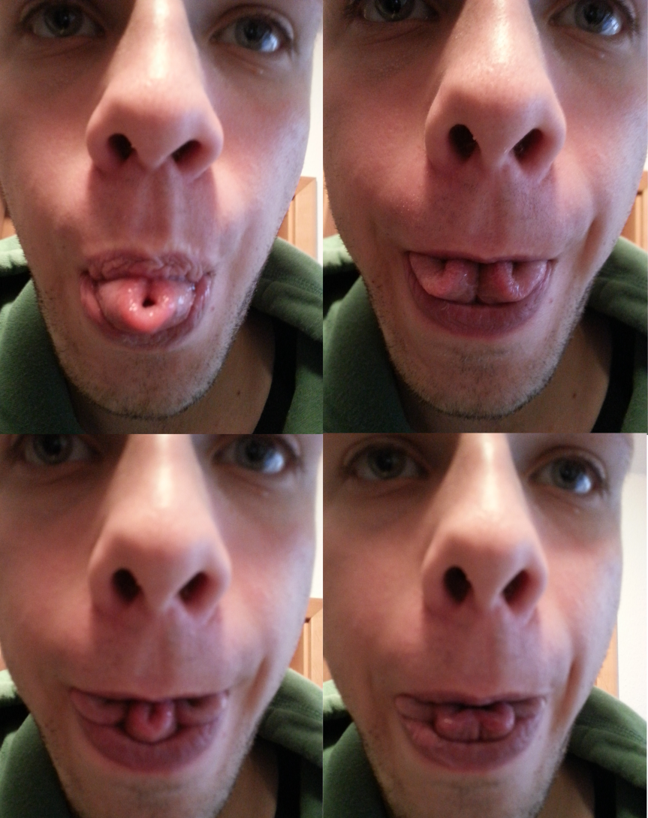

Inheritable vs. Non-Inheritable

Slide 3
Discrete and Continuous Variations

Slide 4
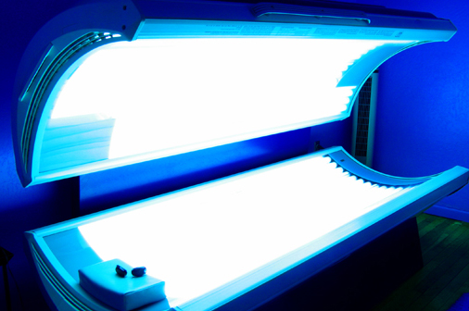
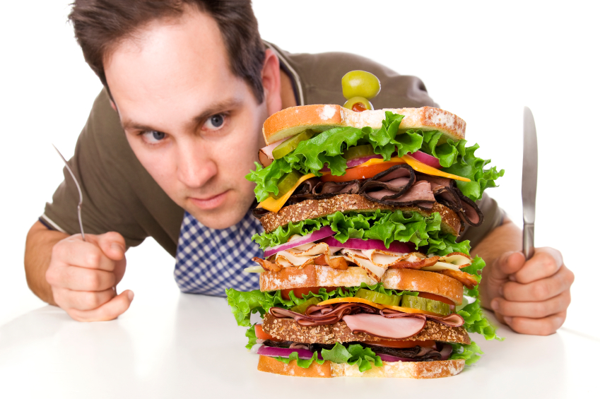
Environmental Influences
Tanning
Nutrition

