Slide 1
Interdependence
Lesson 3

Slide 2
Interdependence

Slide 3
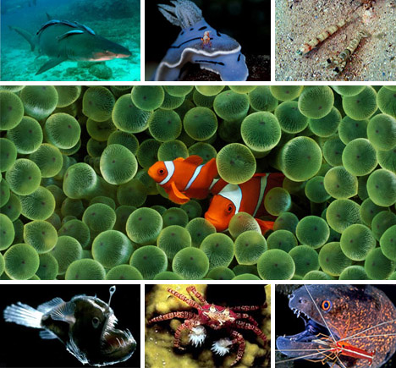
Symbiosis

Slide 4
Mutualism

Slide 5
Commensalism

Slide 6
Parasitism

Slide 7
Niche

Slide 8
What it eats

Slide 9
What eats it

Slide 10
Its Habitat

Slide 11
Nesting site, range and Habits

Slide 12
What effect it has on other populations

Slide 13
What effect it has on the environment

Slide 14
Resource Partitioning

Slide 15
Practice Pg. 19 Q 2-4

