Slide 1
Asexual vs. Sexual Reproduction
Lesson 6

Slide 2
QUIZ
Examples of Variation in Alberta
Unlike most other owl species, which prefer to nest in trees, burrowing owls nest underground.
A bull trout and brook trout look quite similar, but a bull trout lacks black markings on its fins.
Some lodgepole pine trees grow branches near the top; some grow branches along the whole length of the tree
Grizzly Bears can be distinguished from black bears by their broad, round faces and the large humps of muscle on their shoulders

Slide 3
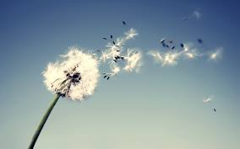
Dandelions

Slide 4
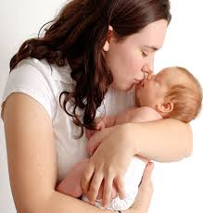
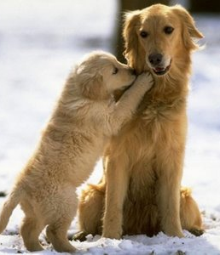
Offspring

Slide 5
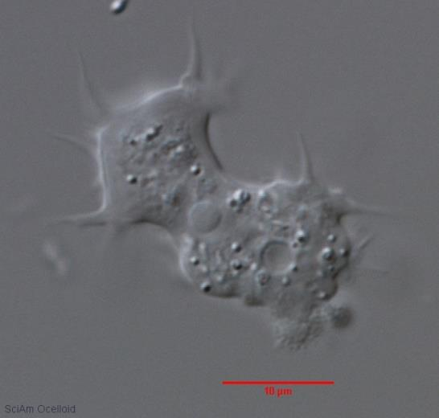
Asexual Reproduction

Slide 6
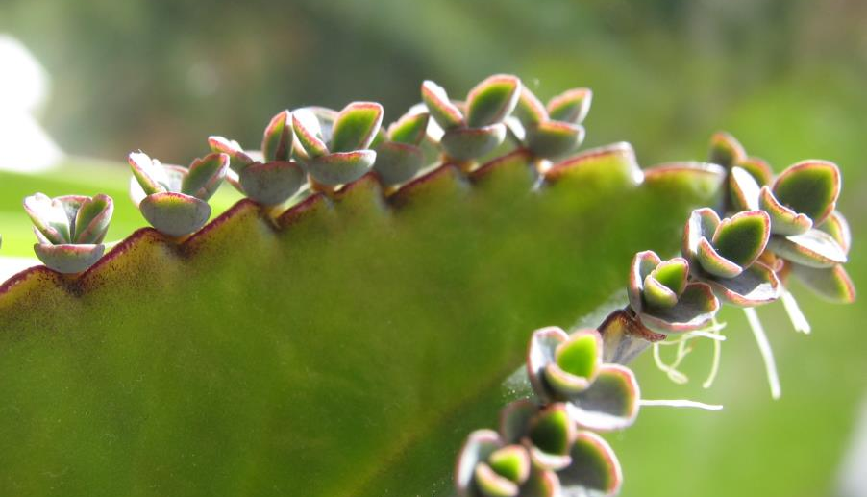
Budding

Slide 7
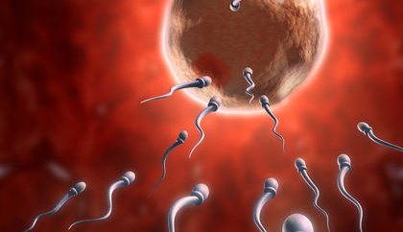
Sexual Reproduction

Slide 8
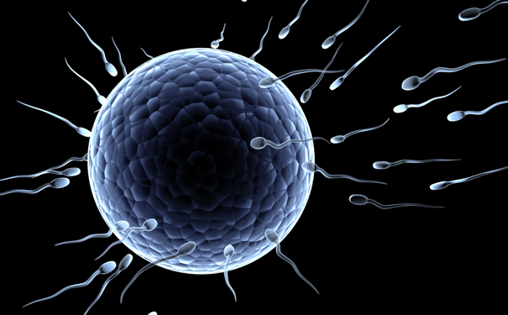
Gametes

Slide 9
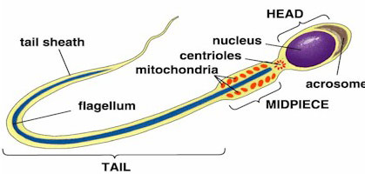
Sperm

Slide 10
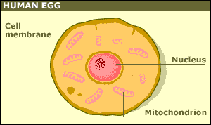
Ova (Eggs)

Slide 11
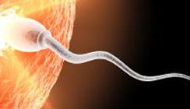
Fertilization

Slide 12
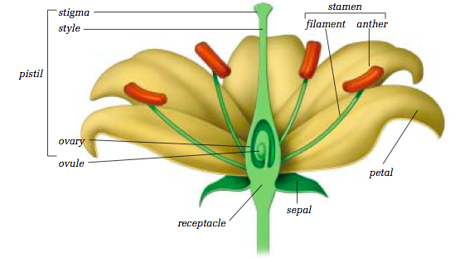
Plant Reproduction Cells and Process

Slide 13
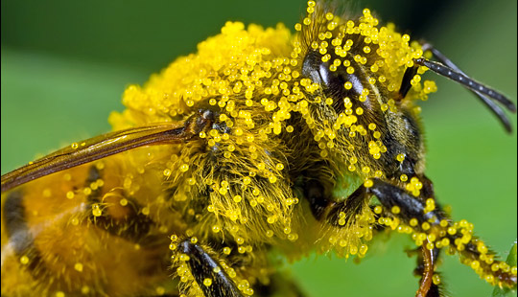
Pollination

Slide 14
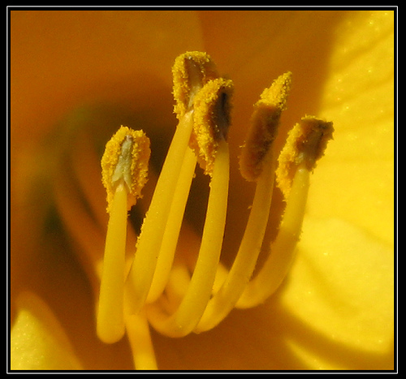
Pollen

Slide 15
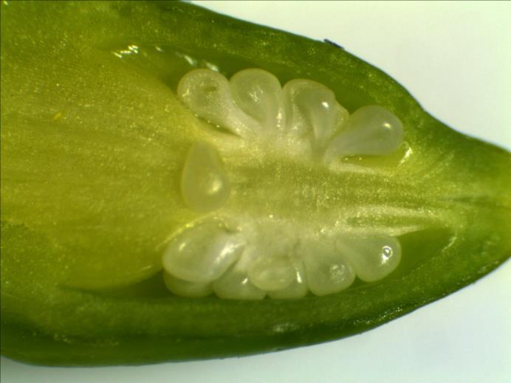
Ovules

Slide 16
Sexual Reproduction
Advantages
Disadvantages
Asexual Reproduction
Advantages
Disadvantages

Slide 17
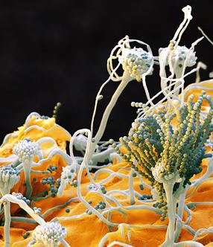
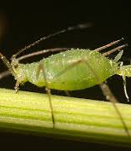
Organisms that Reproduce Both Ways

