Slide 1
Intro to Bio-Diversity
Lesson 2

Slide 2



Species

Slide 3
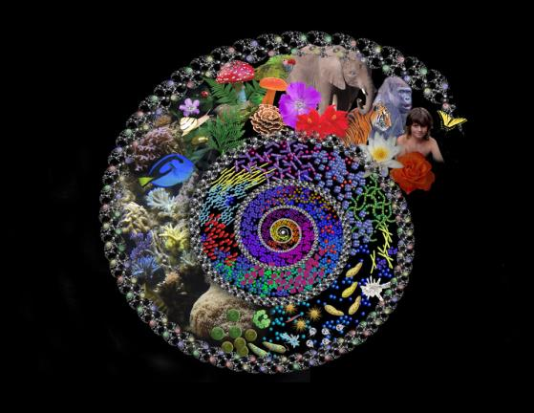
Life

Slide 4
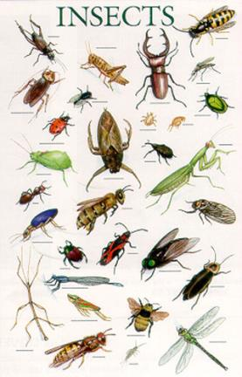
Insects

Slide 5
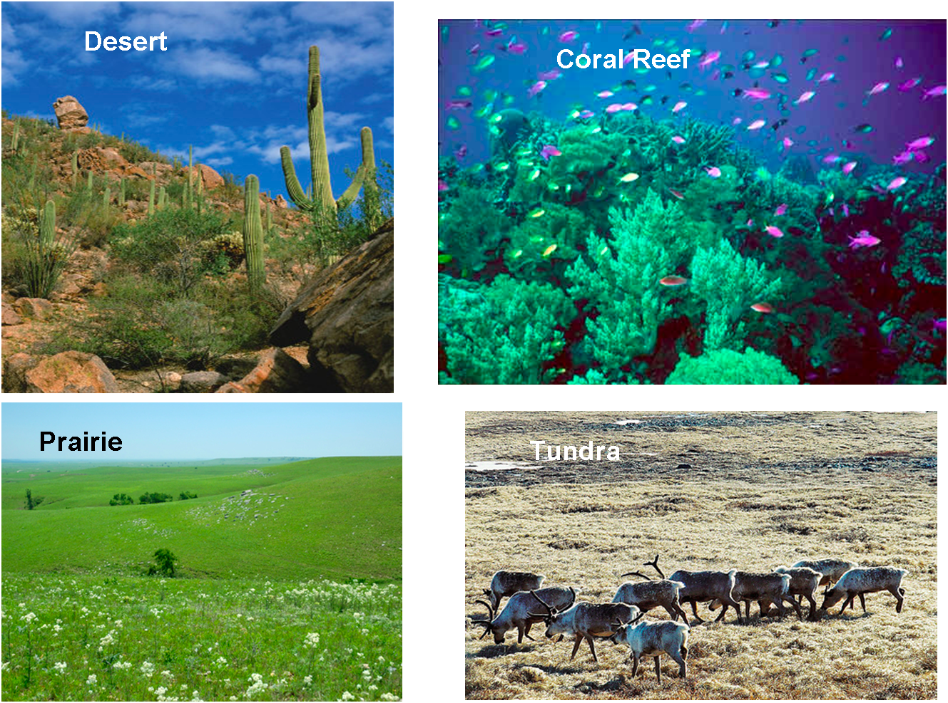
Ecosystem

Slide 6
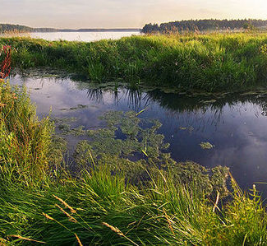
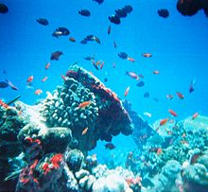
Diversity between Ecosystems
Wetlands
Oceans

Slide 7
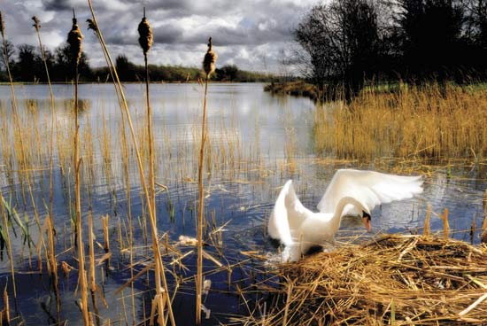
Diversity Within Ecosystems

Slide 8

Diversity within Species

Slide 9
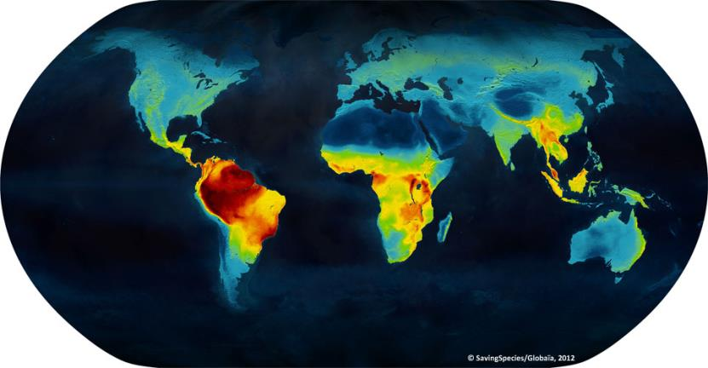
Species Distribution

Slide 10
Practice
In one or two sentences explain why so many different types of organisms exist on Earth today.
Think about a time you have seen a flock of Canada geese (Branta canadensis) flying overhead. If you could examine the geese closely, would they look identical? Explain your answer.
The bubonic plague, or Black Death, kills people every year. However, it was devastating when it swept through Europe in the sixth, fourteenth, and seventeenth centuries. It killed 90% of the people exposed to the germ and resulted in the deaths of approximately 137 million people. Why was everyone not killed by the Black Death?

Slide 11
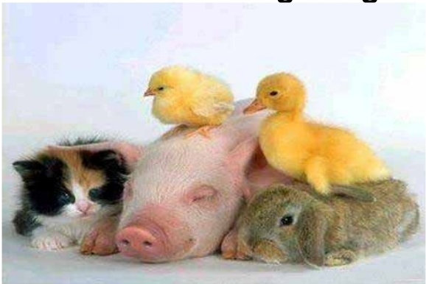
Classification of Species

Slide 12
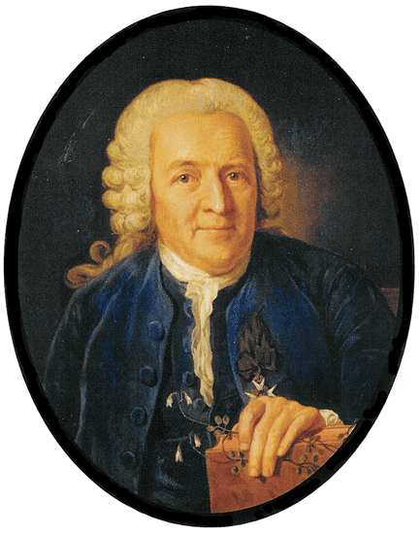
Carolus Linnaeus

Slide 13
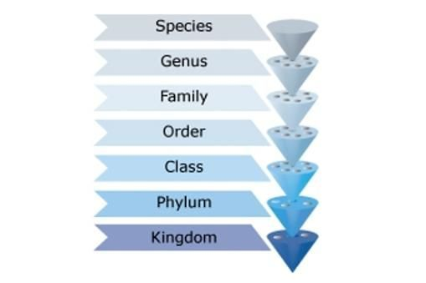
Classification of Life

Slide 14
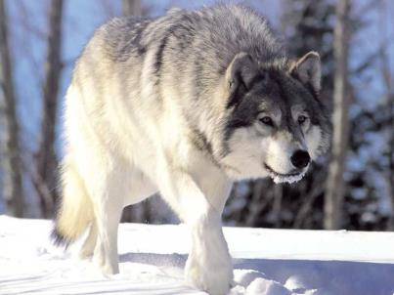
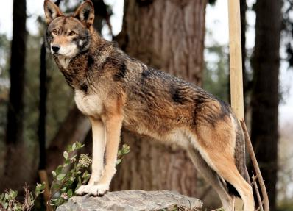
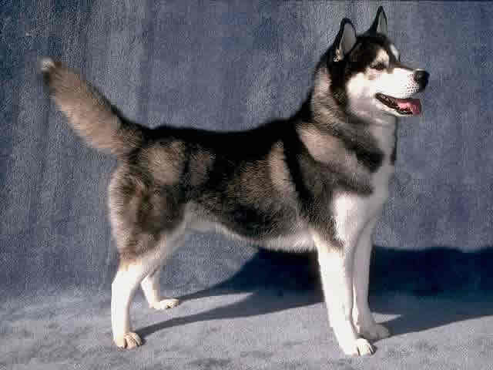
Genus Canis

