Slide 1
Natural Selection/Variation within Species
Lesson 4

Slide 2

Crash Course Video – Natural Selection https://www.youtube.com/watch?v=aTftyFboC_M

Slide 3
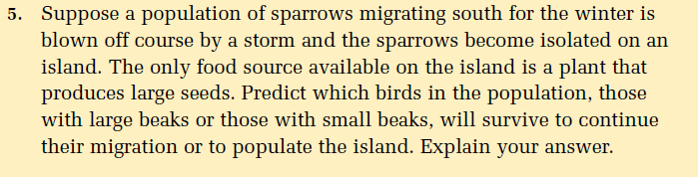
Pg. 24: Question 5

Slide 4
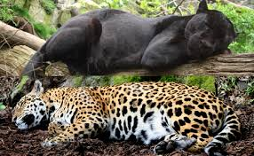
Variation within Species

Slide 5

Variability

Slide 6
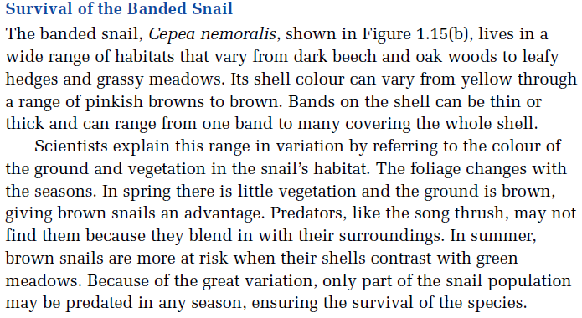
Banded Snail Pg. 23

Slide 7
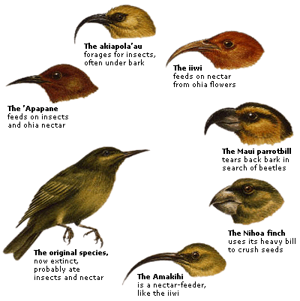
Natural Selection

