Slide 1
Human Activity Affects Biological Diversity
Lesson 9

Slide 2
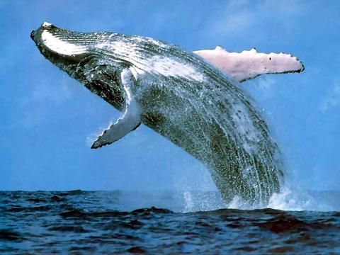
Reduction of Biological Diversity

Slide 3
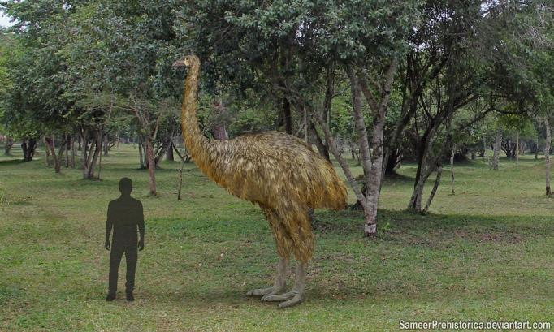
Extinction

Slide 4
Video
https://www.youtube.com/watch?v=FlUes_NPa6M

Slide 5
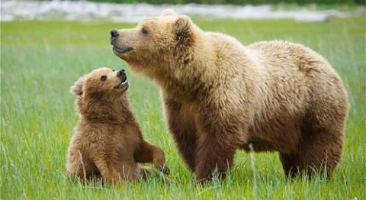
Extirpation

Slide 6
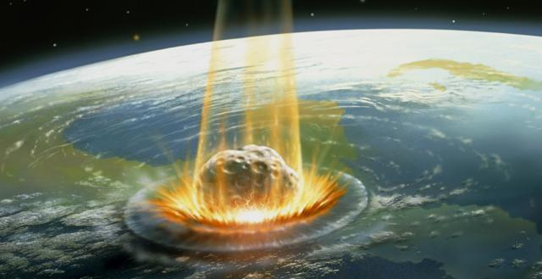
Natural Cause of Extinction and Extirpation

Slide 7
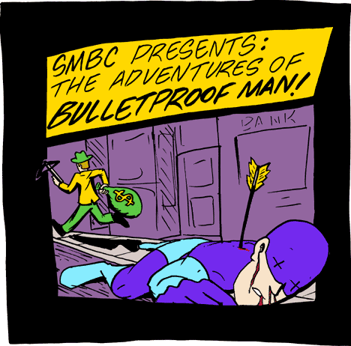
Overspecialization

Slide 8
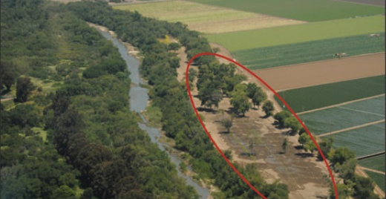
Human Causes of Extinctions and Extirpations

Slide 9
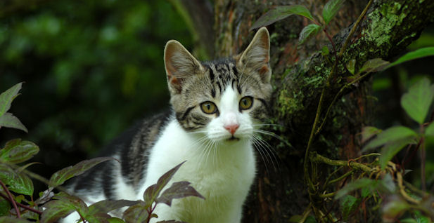
Introduction of Non-Native Species

Slide 10
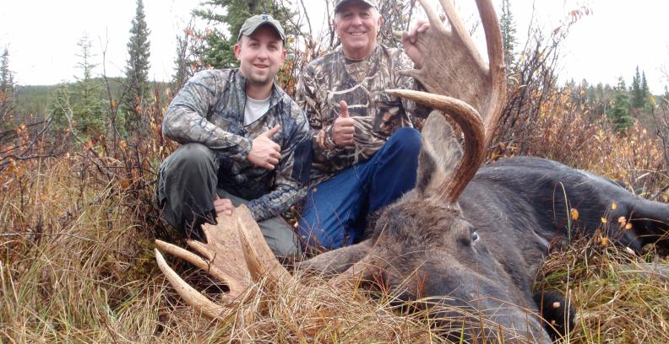
Over-Hunting

Slide 11
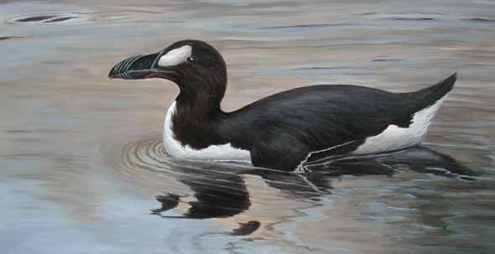
Effects of Extinctions and Extirpations

Slide 12
Practice
Pg. 65 # 1,3,6
State two examples of situations in which biological diversity may be reduced.
In what ways can human activity lead to the extinction or extirpation of a species? Use examples to explain your answer.
Suppose an organism is extirpated from a local environment. In what way might other organisms be affected? Provide examples to support your answer.

Slide 13
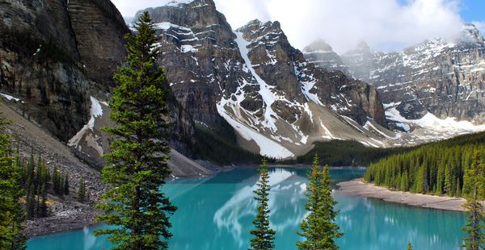
Reducing our Impact

Slide 14
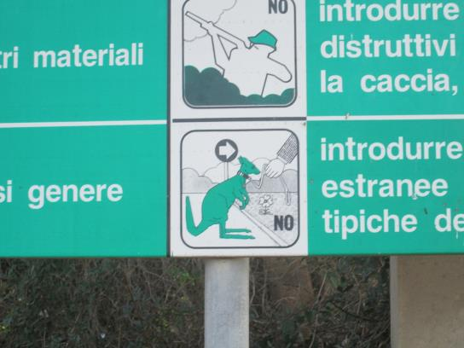
Protected Areas

Slide 15

Restoration Programs

Slide 16
Resource Use Polices
http://www.ec.gc.ca/alef-ewe/default.asp?lang=en&n=ED2FFC37-1

Slide 17
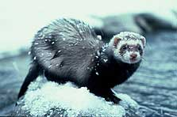
Controlling the Spread of Exotic Species

Slide 18
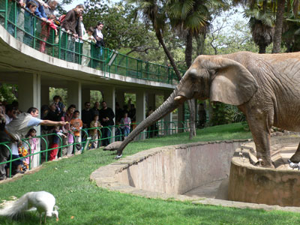
Conservation of Genetic Resources

Slide 19
Practice
Pg. 78: 1, 3, 6, 7
What is in-situ conservation? How does it preserve biological diversity?
How have governments been involved in the protection of vulnerable species? Provide an example of a government policy.
Why do exotic species have such an impact on local ecosystems? Why are exotic species, such as purple loosestrife, a threat to biological diversity?
What is the value of preserving the seed of wild plant ancestors and other varieties of crop plants grown today?

Slide 20
Next Class
Working on a research project

